Slide 2
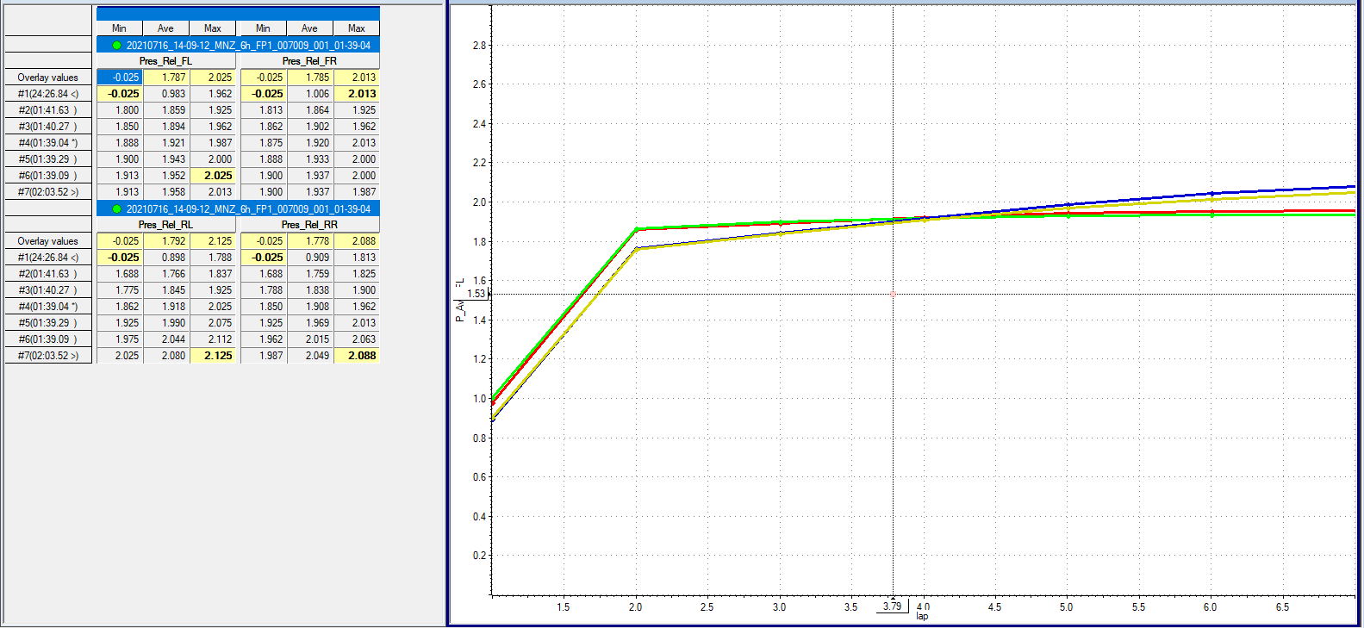

Outing #1 Driver:RD Tyre pressure

Slide 3
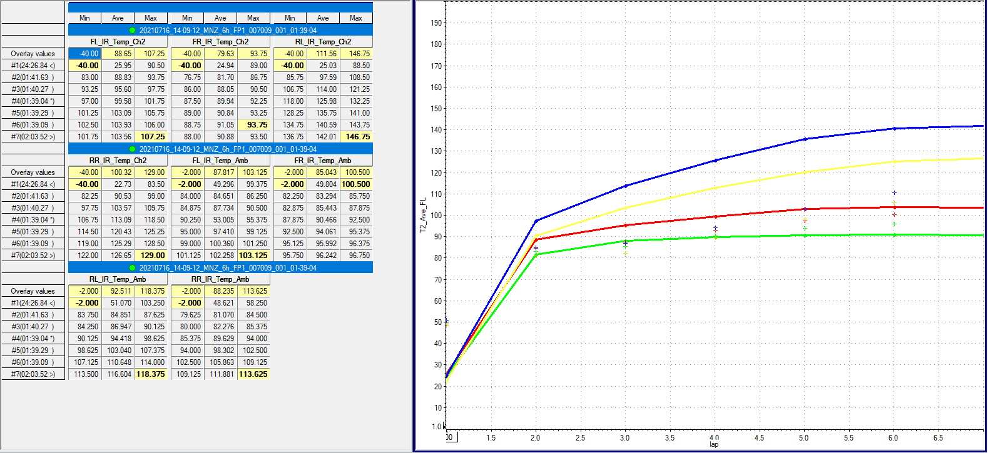
Outing #1 Driver:RD Tyre surf and gas temp
+: gas temps line: surface temps

Slide 4
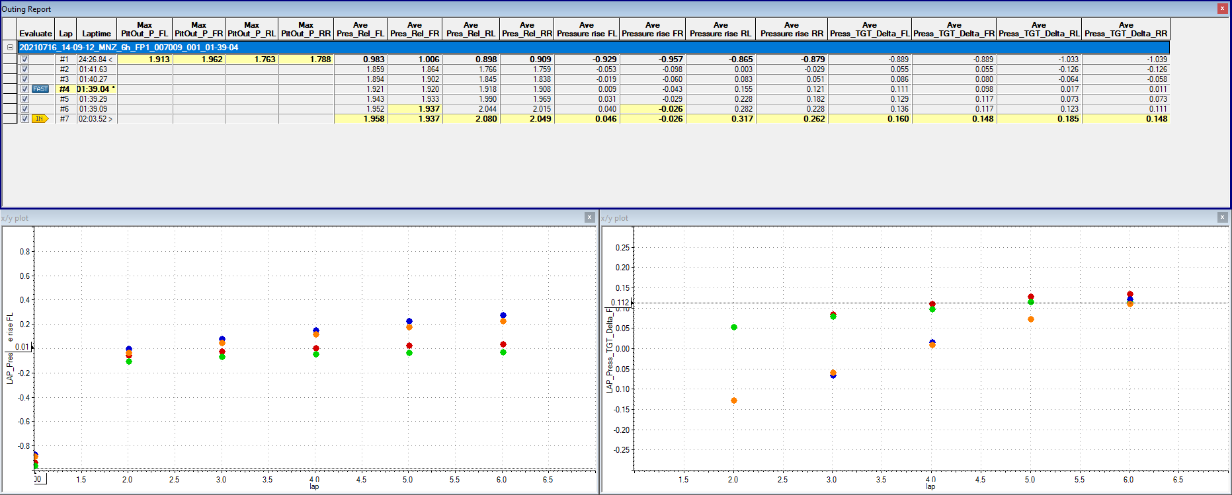
Outing #1 Driver:RD Pressure rise from pit out, delta from target
Rise from Pit Out
Delta from Target

Slide 5
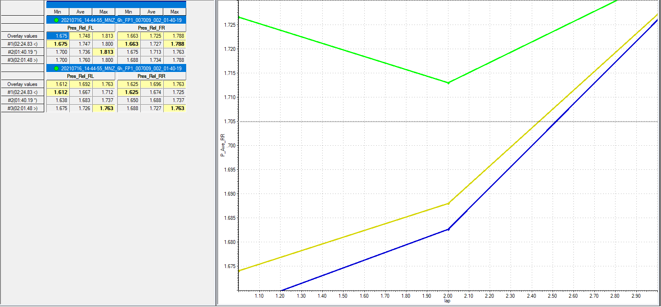
Outing #2 Driver:RD Tyre pressure

Slide 6
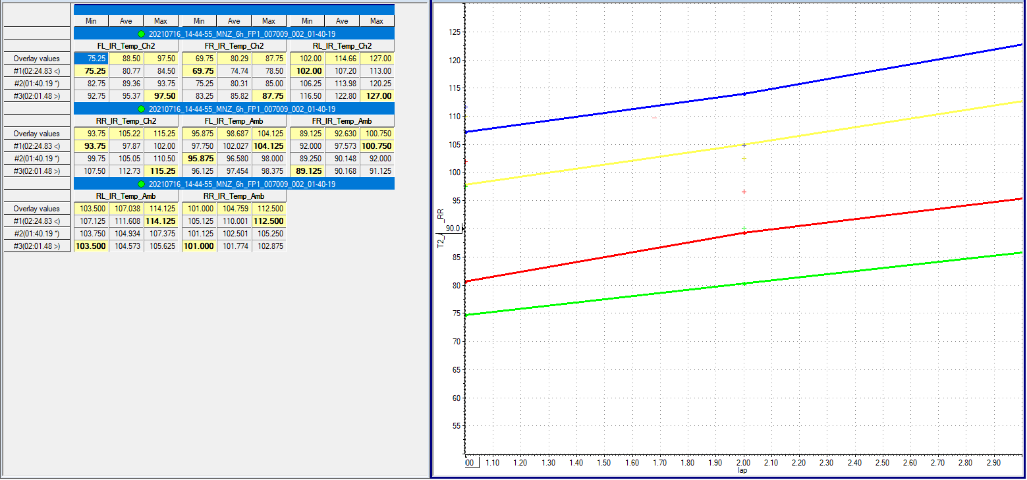
Outing #2 Driver:RD Tyre surf and gas temp
+: gas temps line: surface temps

Slide 7
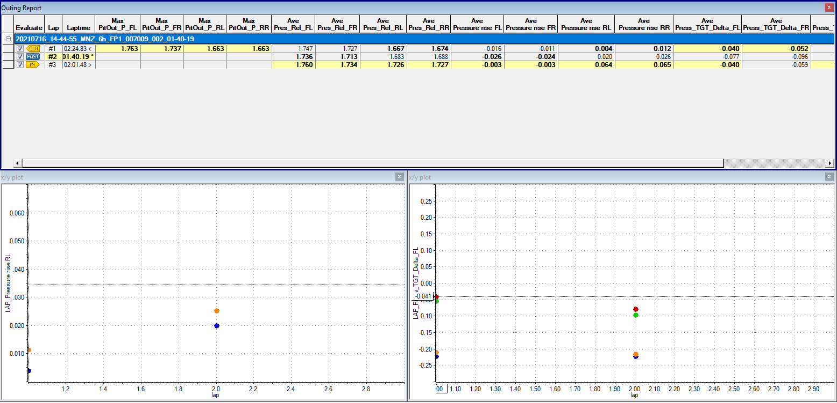
Outing #2 Driver:RD Pressure rise from pit out, delta from target
Rise from Pit Out
Delta from Target

Slide 8
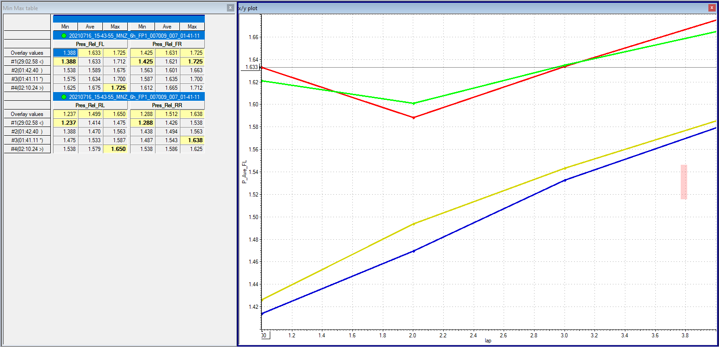
Outing #3 Driver:RW Tyre pressure

Slide 9
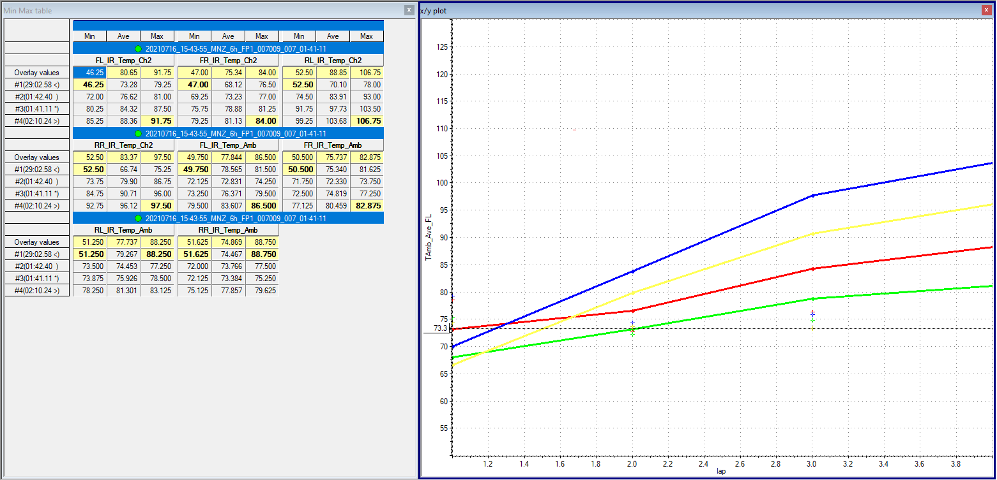
Outing #3 Driver:RW Tyre surf and gas temp
+: gas temps line: surface temps

Slide 10
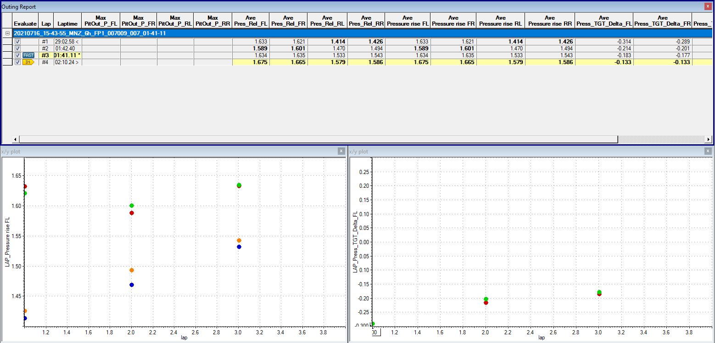
Outing #3 Driver:RW Pressure rise from pit out, delta from target
Rise from Pit Out
Delta from Target

Slide 11
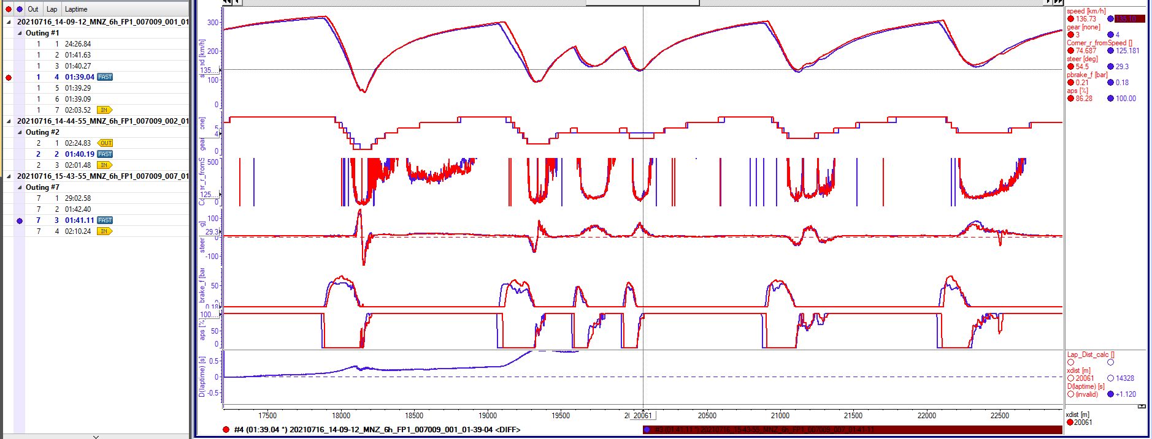
Driver best lap comparison
Red : RD Blue: RW

Slide 12
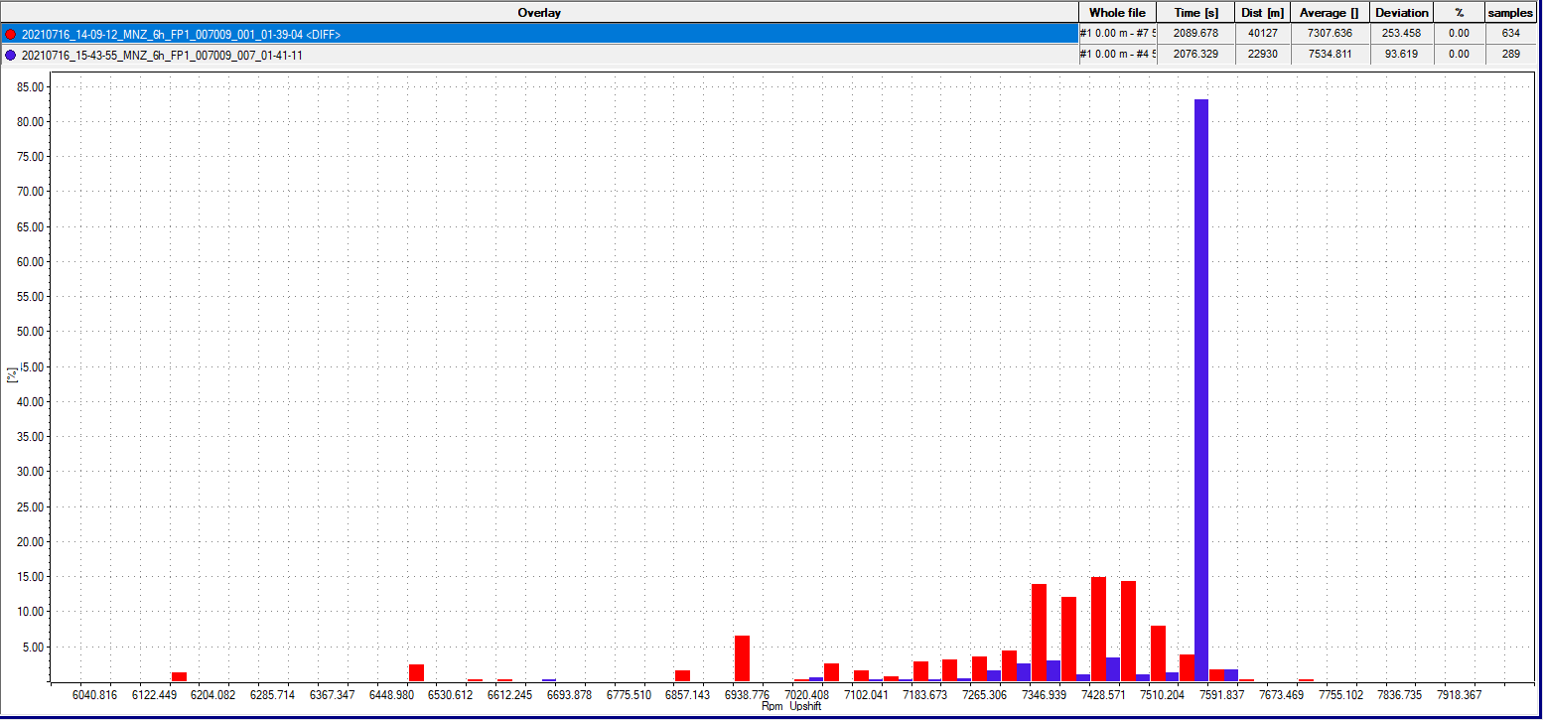
RPM @upshift
Red : RD Blue: RW

Slide 13
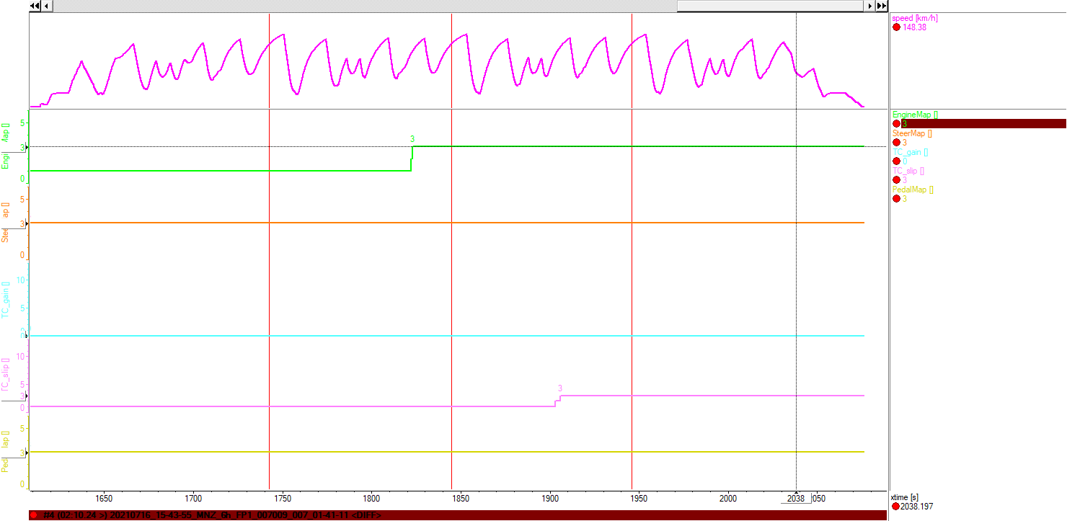
Steering Wheel Config
Last RW Stint with #708 Steering Wheel

